Slide 1
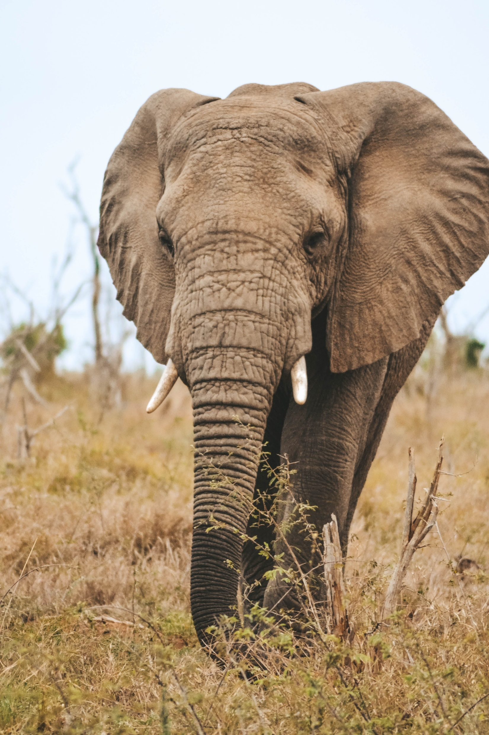


WildTask
Sponsored By
Team Lambda++
Team 18
Gage Nott
Kevin Kiyo
Abu Zar Bulbulia
Ariel Sischy

Slide 2
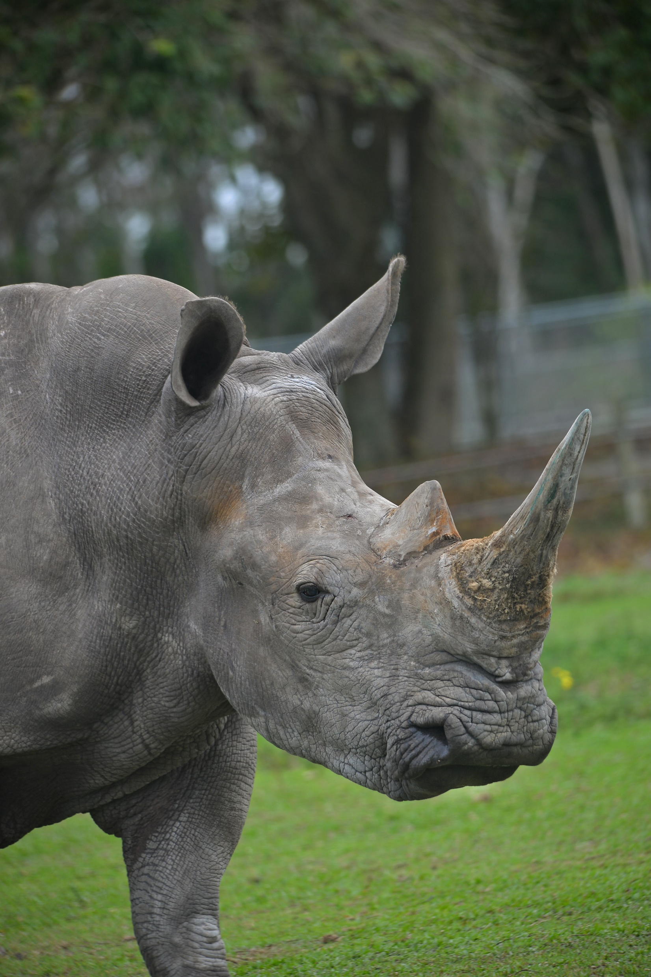
Background
System for Melorane Game Reserve.
Rhino, elephant reserve collaboration.
Non-profit ERP lease, community-focused.
Community empowerment, wildlife opportunities.
Growing team, expanding possibilities.
Team-based conservation, wildlife preservation.

Slide 3

Problem Statement
Administrator manages reserve activities.
No activity assignment, progress tracking.
Untracked skills, employee availability.
No formal resource tracking, requesting.

Slide 4

Proposed Solution
Web app: Manage employees, tasks.
Mobile app: Task tracking, progress.
Mobile app: Stock oversight, access.
Tech boosts productivity, coordination.

Slide 5
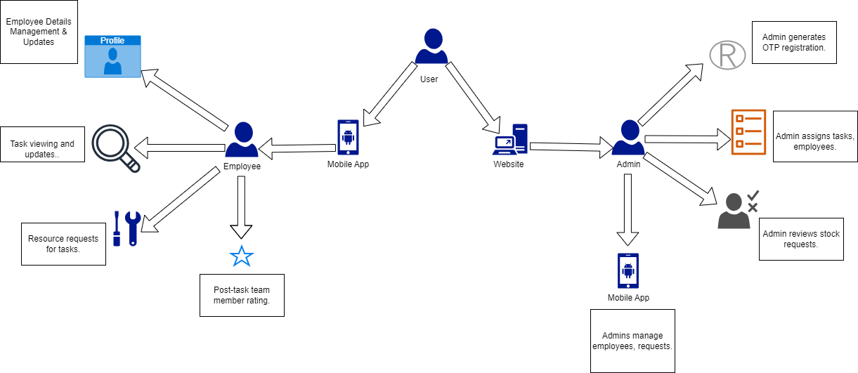
Rich Picture

